Slide 2
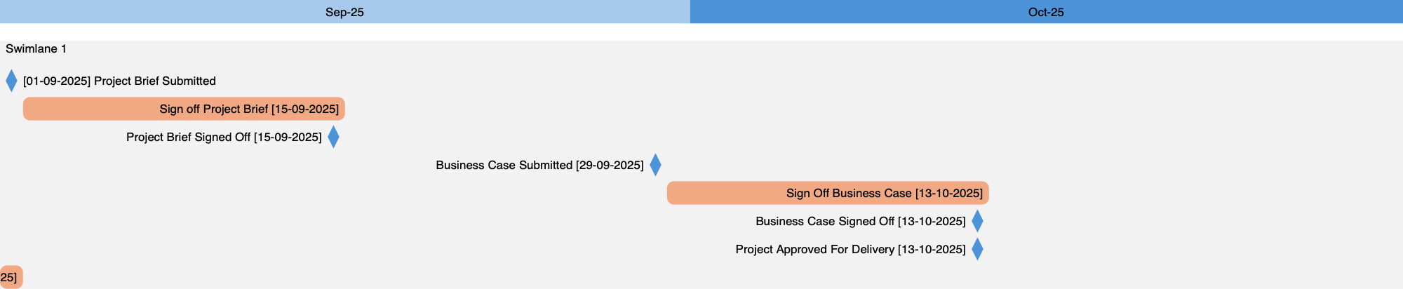

Slide 3
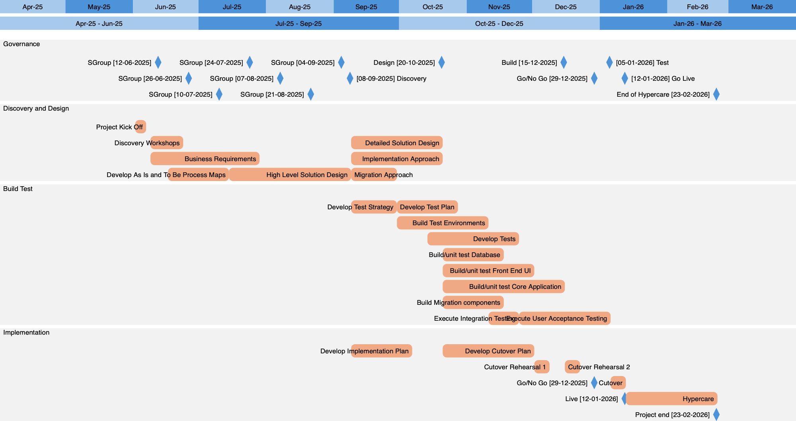
Plan on
ONE
Page

Slide 4
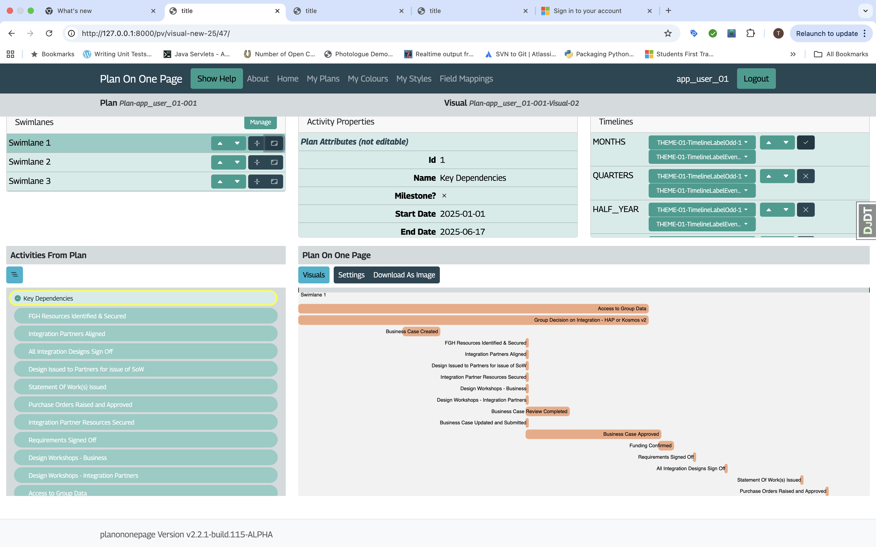
Activity Panel
This panel shows the attributes of the current selected activity, such as the Name, Start Date, End Date, Shape, Style etc.
The attributes are grouped under Plan Attributes, and Visual Attributes.
Visual attributes, such as Style, are only populated for activities which are in the visual.
When the visual properties are shown, they can be edited (such as shape to be used for the activity, style, etc.
Manage Swimlanes
Allows you to:
Select the default swimlane which new activities will be added to.
Change the order of swimlanes
Compress the swimlane by removing blank tracks.
Sort the activities in a swimlane by start date
Navigate to the manage swimlanes screen to edit properties or add new swimlanes.
Timeline Panel
This panel lists all the available timelines (e.g. months, quarters) and allows you to toggle which are included in the visual, and also to change the order of them.
You can also change the style to be used for Odd and Even numbered labels within each timeline.
Add/Remove Activities
This panel shows the activities from your uploaded plan in a collapsed tree structure.
You can expand or contract parent activities to show or hide child activities.
When you click on an activity that activity is highlighted. If you click on the activity again it’s inclusion in the visual is toggled.
The highlighted activity is also highlighted in the visual if it is currently toggle in.
You can add all next level sub-activities into the visual by clicking the icon at the top of this panel.
The Visual
This panel shows the visual that you are creating. From here you can download the visual as a .PNG file, navigate to the Settings for this visual or go back to the Manage Visuals page.

